Slide 1

CSE 309 (Compilers)
Part II
Khaled Mahmud Shahriar
Assistant Professor
Department of CSE, BUET
January 2021

Slide 2
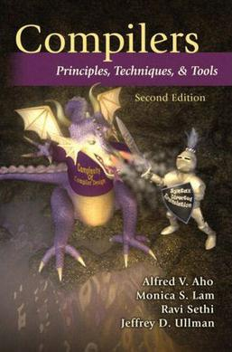
Text Book
Compilers: Principles, Techniques, and Tools (2nd Edition)
by Alfred Aho, Monica Lam, Ravi Sethi, Jeffrey Ullman
Pearson/Addison Wesley, 2007

Slide 3
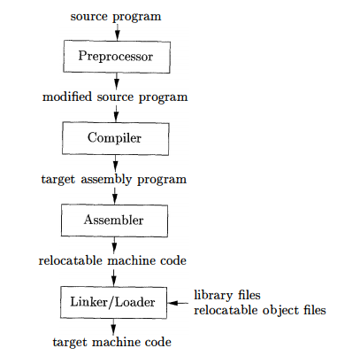
A Language Processing System
CSE 309

Slide 4
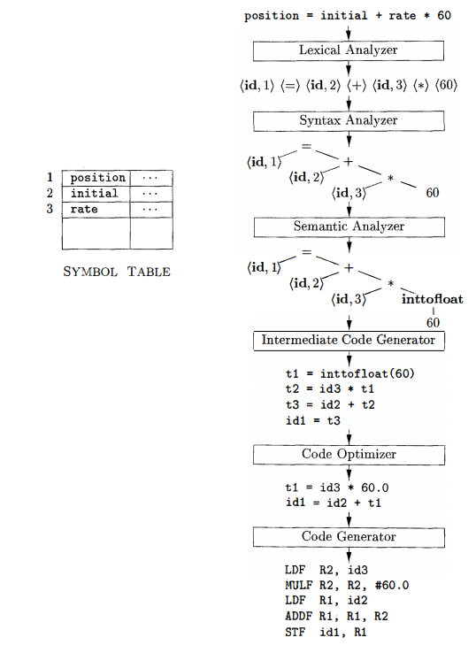
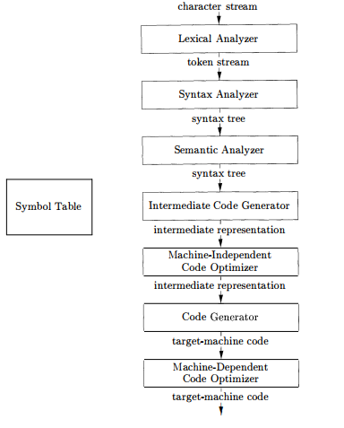
Phases of A Compiler
Front End
Part I
(by MMA)
Back End
Part II
(by KMS)

Slide 5
Topics To be Covered
Syntax-Directed Translation (Chapter 5)
Intermediate-Code Generation (Chapter 6)
Runtime Environments (Chapter 7)
Code Generation (Chapter 8)
Machine-Independent Optimizations (Chapter 9)

Slide 6
Chapter 5 Syntax Directed Translations

Slide 7
Syntax-Directed Definitions
A context free grammar together with attributes and rules
Attributes associated with grammar symbols
Rules associated with productions
Rules calculate attributes
If a is an attribute of grammar symbol X, then X.a denotes the value of a at a particular parse tree node labeled as X.

Slide 8
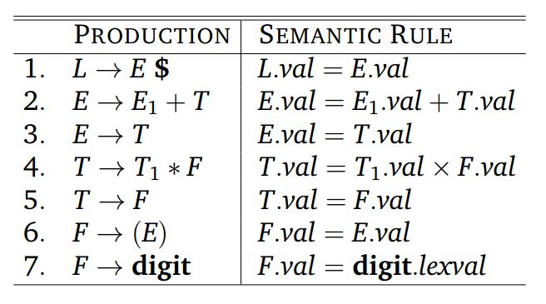
Syntax-Directed Definitions
Example: SDD for desk calculator
What are the attributes?
val and lexval

Slide 9
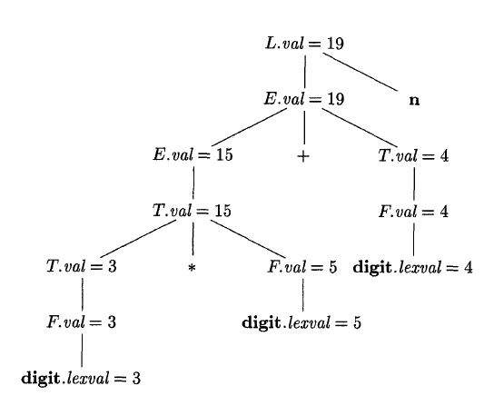
Annotated Parse Tree
A parse tree showing value of the attributes
$
Annotated parse tree for 3 * 5 + 4 $

Slide 10
Synthesized and Inherited Attributes
Need to deal with two kinds of attributes for nonterminals
Synthesized Attributes
Inherited Attributes

Slide 11

Synthesized and Inherited Attributes
Synthesized attributes at node N are defined only in terms of the attribute value of the children of N, and N itself
Defined at rule of N node

Slide 12
Synthesized and Inherited Attributes
Synthesized attributes at node N are defined only in terms of the attribute value of the children of N, and N itself
Defined at rule of N node
N

Slide 13
Synthesized and Inherited Attributes
Inherited attributes at node N are defined only in terms of the attribute value N’s parent, N itself and N’s siblings
Defined at rule of parent node of N node

Slide 14
Synthesized and Inherited Attributes
Inherited attributes at node N are defined only in terms of the attribute value N’s parent, N itself and N’s siblings
Defined at rule of parent node of N node
N

Slide 15
Synthesized and Inherited Attributes
Synthesized attribute at node N can be defined in terms of inherited values of N
Inherited attributes at node N cannot be defined in terms of attribute values of children on N node
Terminals can have synthesized attributes only
Supplied by Scanner

Slide 16
Synthesized and Inherited Attributes
Are the attributes synthesized or inherited?
val and lexval are both synthesized

Slide 17
Synthesized and Inherited Attributes
Attribute Grammar:
SDD with no side effects i.e. no print, symbol table insertion
Define value of an attribute purely on other attributes and constants
S-attributed SDD:
All attributes are synthesized
Each rule computes attribute for head in terms of attributes of nonterminals from body

Slide 18
Synthesized and Inherited Attributes
This can be also called Attribute Grammar
And S-attributed

Slide 19
Evaluating an SDD
Suppose we have constructed a parse tree first
Attributes will be evaluated at each node
A parse tree may not be needed to be built in practice
In what order do we evaluate attributes?
For an S-attributed SDD we must evaluate in bottom-up order (like post-order traversal)
But what if there are inherited attributes also

Slide 20
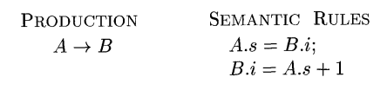
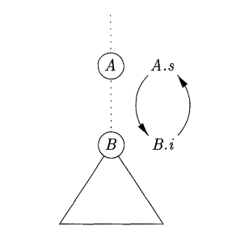
Evaluating an SDD
Not every time we will find an evaluation order
Circular dependency

Slide 21
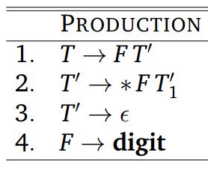
Another Example
What does the following grammar recognize?
Did we see something like this previously?
Yes!
Recognizes string like 3*5*7

Slide 22
Another Example
Parse tree for 3*5
How can we calculate value of the product?
T
F
T’
digit
F
T’
*
digit
Ɛ

Slide 23
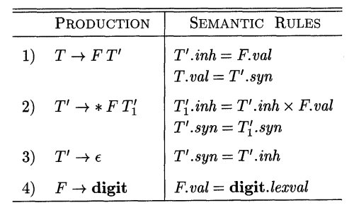
Another Example
Introducing an inherited attribute

Slide 24
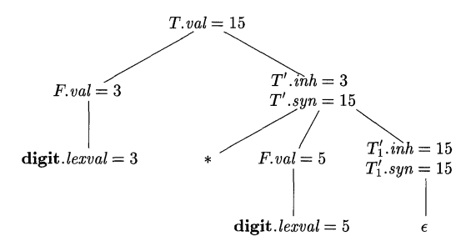
Another Example
Introducing an inherited attribute
Annotated parse tree for 3 * 5

Slide 25
Another Example
How it works?

Slide 26
Evaluation Order of SDD
What is the evaluation order for the attribute instance in a given parse tree?
Not always possible (Remember?)
Useful tool:
Dependency Graph

Slide 27
Dependency Graph
Depicts flow of information among attribute instances in a particular parse tree
Nodes represent attribute instances
Nodes for all attributes at a given parse tree nodes
An edge from one attribute to another means that the first attribute is needed to compute the second
Edge represent constraint implied by semantic rule

Slide 28
Dependency Graph
Example 1:
Production Semantic Rule
E -> TF F.a=E.a+T.b
E
a
a
T
b
F

Slide 29

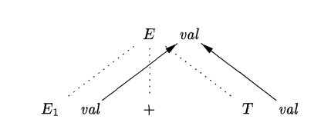
Dependency Graph
Example 2:

Slide 30
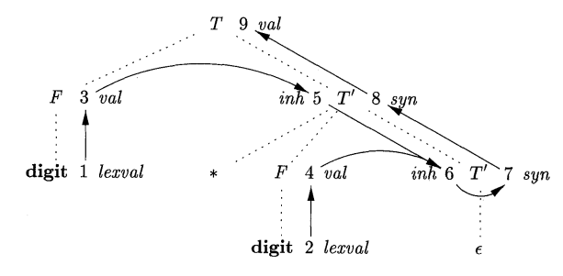
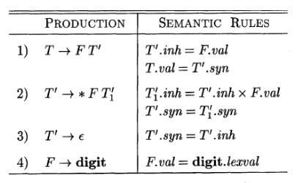
Dependency Graph
Example 3:
Dependency Graph for 1*2

Slide 31
Dependency Graph
Allowable Order : N₁, N₂, N₃,…, N_{k} such that, if there is an edge from N_{i} to N_{j} then i<j
Called Topological sort
If a directed graph is acyclic, then there is always at least one topological sort

Slide 32
Well Behaved SDD classes
Difficult to tell whether there exist any dependency graph with cycle
Safe way: Use classes of SDD that guarantees evaluation order
S-attributed SDD
L-attributed SDD

Slide 33
S-attributed SDD
We already know!
All attributes are synthesized
Can be calculated in bottom up order
Post Order Traversal on Parse Tree
Can be implemented during bottom-up parsing, without creating tree nodes explicitly

Slide 34
L-attributed SDD
Between attributes of a production body, dependency graph edges can go from left to right
Attributes can be
Synthesized
Inherited with some restrictions

Slide 35
L-attributed SDD
For A -> X₁X₂X₃ … X_{n}, X_{i}.a is an inherited attribute computed by a rule associated with this production
The rule may use
Inherited attribute associated with head
X_{i}.a= f(A.inh, …), where inh is an inherited attribute of A

Slide 36
L-attributed SDD
For A -> X₁X₂X₃ … X_{n}, X_{i}.a is an inherited attribute computed by a rule associated with this production
The rule may use
Either inherited or synthesized attribute associated with occurrence of X₁, X₂, X₃, … , X_{i-1}
X₅.a= f(X₂.a, X₃.b,…)

Slide 37
L-attributed SDD
For A -> X₁X₂X₃ … X_{n}, X_{i}.a is an inherited attribute computed by a rule associated with this production
The rule may use
Either inherited or synthesized attribute associated with this occurrence of X_{i}, without creating cycle
X₅.a= f(X₅.b, …)

Slide 38
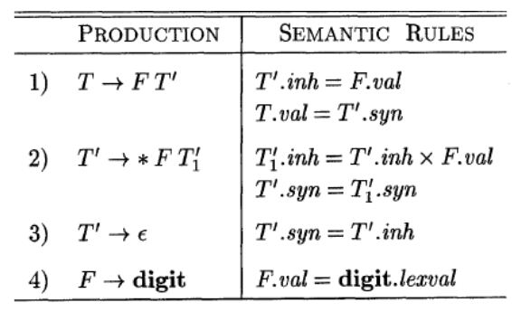
L-attributed SDD
Example of L-attributed SDD

Slide 39
L-attributed SDD
val (of both T and F), syn and lexval are synthesized

Slide 40
L-attributed SDD
inh is inherited

Slide 41
L-attributed SDD
inh is inherited
Rule 2
Rule 1 & 2

Slide 42
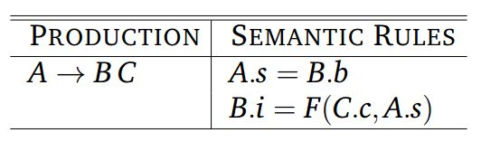
L-attributed SDD
Can any grammar with following rule be S or L-attributed?
NO! Why?

Slide 43

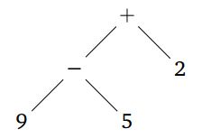
SDT Application: Construction of AST
Tree | Internal Nodes
Syntax Tree | Language Construct
Parse Tree | Non-terminals
E
E
+
E
E
-
E
2
9
5
Abstract Syntax tree
Parse tree

Slide 44
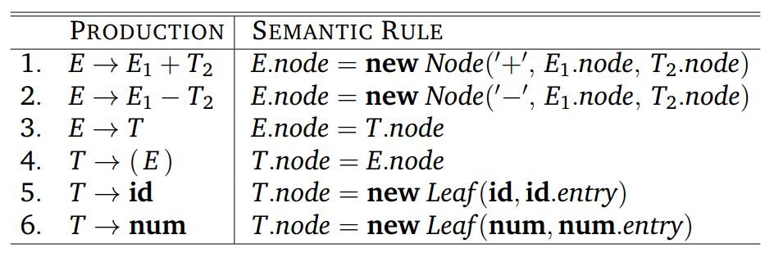
Construction of AST
Example 1: AST construction in S-attributed SDD

Slide 45
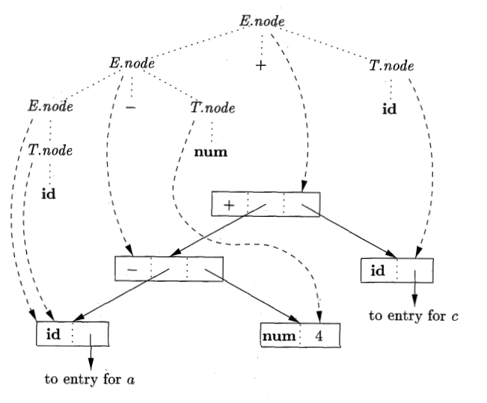
Construction of AST
Syntax tree for a-4+c

Slide 46
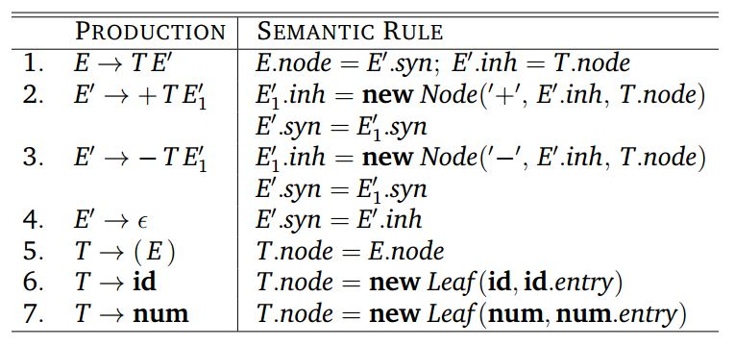
Construction of AST
Example 2: AST construction in L-attributed SDD
Just like we calculated value previously!

Slide 47
Syntax-Directed Translation Schemes
SDT is complementary notation of SDD
SDD easier to read
SDT easier to implement
All SDD we encountered so far can be implemented using SDT
SDT is a context free grammar with program fragments (Semantic Actions) embedded in production body
Semantic Action can appear any place of production body

Slide 48
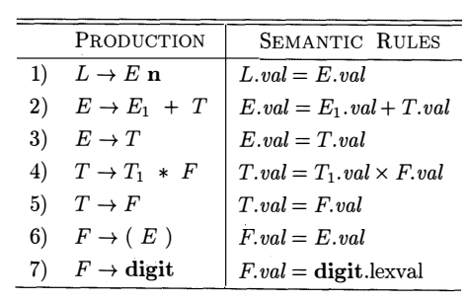
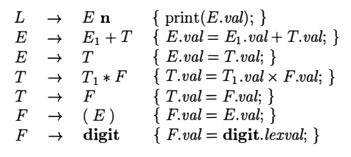
SDD vs. SDT
SDD
SDT

Slide 49
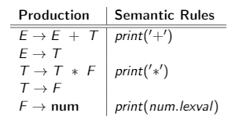
Another Example
Consider the following SDD
What this SDD do?
Convert infix expression to postfix

Slide 50
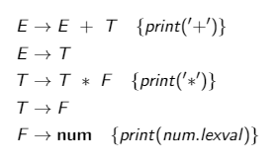
Another Example
SDT for infix to postfix conversion

Slide 51
Syntax-Directed Translation Schemes
Any SDT can be implemented by preorder traversal on parse tree
Evaluation order is fixed unlike SDD
Determined by the order of actions in production body (left to right)
Typically, can be implemented during parsing
We focus on two classes
LR grammar with S-attributed SDD
LL grammar with L-attributed SDD
Need to convert semantic rules of SDD to an SDT with actions where action execute at right time.

Slide 52
Postfix SDT
SDTs with all the actions at the right ends of the production body
The previous two examples are posftfix SDTs
Postfix SDT can be constructed if the grammar can be parsed bottom up and the SDD is S-Attributed
Each action is executed along with the reduction of the body to the head of the production

Slide 53
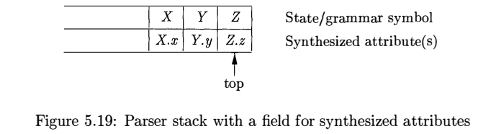
Parser-Stack Implementation of Postfix SDT
The attribute(s) of each grammar symbol can be put on the stack in a place where they can be found during reduction
The best plan is to place the attributes along with the grammar symbol (or the LR states that represent these symbols) in records on the stack itself
In example below, if we reduce by a production such as A->XYZ, then all the attributes are available at known positions of the stack
After the action, A and its attributes are at the top of the stack, in the position of record X.

Slide 54
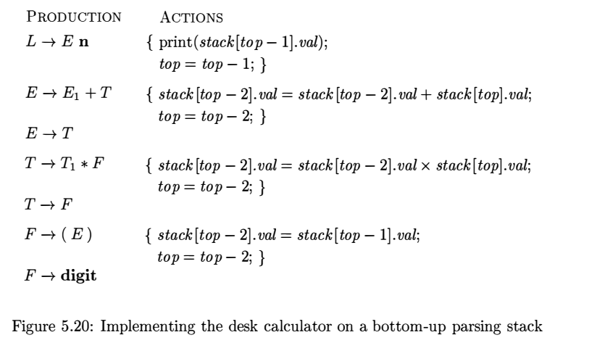
Parser-Stack Implementation of Postfix SDT

Slide 55
SDTs with Action Inside Procedure
An action can be places at any position of the production body
Performed immediately after all symbols to its left are processed
For B -> X {a} Y, action a is performed after recognizing X or all terminals derived from X
Bottom up parsing: As soon as X appears in the stack
Top down parsing: Before expanding Y or checking Y in input

Slide 56
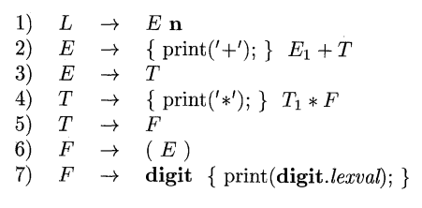
SDTs Non Implementable during Parsing
Example: Conversion to Prefix form
This example cannot be implemented during top-down or bottom up parsing
Doing critical task before knowing input

Slide 57
SDTs Non Implementable during Parsing
So, what to do with the previous SDT? Not implementable at all?
Any SDT can be implemented using:
Produce parse tree ignoring action
For each internal node, insert additional children at appropriate place representing actions if any
Perform preorder traversal and perform action at nodes corresponding to action

Slide 58
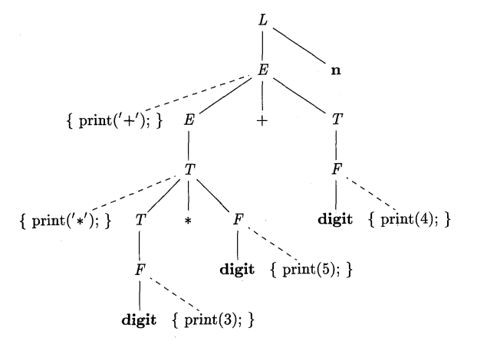
SDT Implementation using Parse Tree
Action embedded parse tree for expression 3*5+4

Slide 59

Eliminating Left Recursion
Why again? We already know!
Consider the following postfix SDT
It converts infix expression to prefix
Good with bottom-up parsing
Does it also good for top-down parsing?
No! Need to remove left recursion
With action in production body, it becomes bit tricky
Need to preserve order

Slide 60


Eliminating Left Recursion
Recap:
Grammar with left recursion
After eliminating left recursion

Slide 61
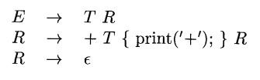
Eliminating Left Recursion
Case 1: when we only care about the order in which actions in an SDT are performed
For example, printing s tring
Treat the actions as if they are terminal symbols
Grammar transformation preserves the order of the terminals in the generated string
Therefore, the actions are executed in the same order in any left-to-right parse, top-down or bottom-up
SDT with left recursion
SDT without left recursion

Slide 62


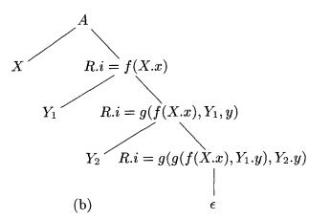
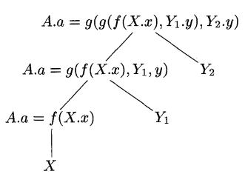
Eliminating Left Recursion
Case 2: Actions Involving Attribute Calculation
SDT with left recursion
CFG without left recursion
Annotated parse tree
Annotated parse tree

Slide 63

Eliminating Left Recursion
Case 2: Actions Involving Attribute Calculation
SDT with left recursion
SDT without left recursion

Slide 64
SDT for L-Attributed SDD
We want to convert L-attributed SDD to SDT
Suppose the underlying grammar can be parsed top-down
Translation can be done in connection with LL or LR parser
Otherwise need to construct parse tree and traverse it

Slide 65
SDT for L-Attributed SDD
Rules for conversion:
Embed the action that computes the inherited attributes for a nonterminal A immediately before that occurrence of A in the body of the production.
Arrange calculation of inherited attributes of A so that dependency is maintained
Place the actions that compute a synthesized attribute for the head of a production at the end of the body of that production.

Slide 66
SDT for L-Attributed SDD
Example:

Slide 67
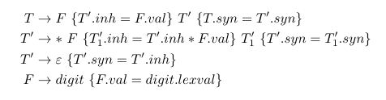

SDT for L-Attributed SDD
Example:
$$val$$

Slide 68
Reference
Compilers: Principles, Techniques, & Tools, by
Alfred B. Aho, Monica S. Lam, Ravi Sethi, Jeffrey D. Ullman
Chapter 5
5.1
5.2
5.3
5.4

